Slide 1





SALES PERFORMANCE ANALYSIS REPORT
GROWTH AND EXPANSION
JANUARY -DECEMBER 2020
Presented byANJOUS BABAJIDE .G.

Slide 2

FACTS
RECOMMENDATIONS
INSIGHT
GROWTH AND
EXPANSION
EKITI
LAGOS
BRANDS
MODEL
TRENDS
TEAM
BRANCHES
BRANCHES
BRANDS
M0DEL
TRENDS
GENDER
AGE
POPULATION
ECONOMIC POWER
LAGOS
OSUN
OGUN
OYO
ONDO
EKITI

Slide 3
Total number of cars sold across branches is 1491
Average monthly monthly growth rate is
4.27%

Slide 4
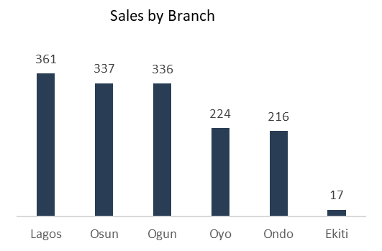
lagos- highest sales Ekiti- lowest sales

Slide 5
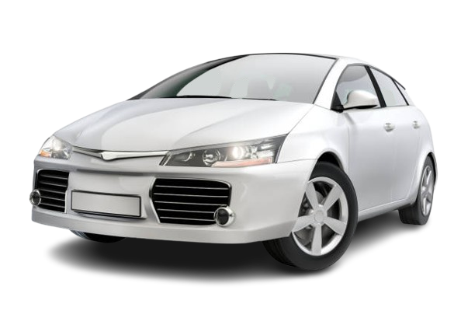
Branch
Osun State
Sales Volume
337
Growth Rate
3.69%
No.1 Car
Toyota Corolla 46%
Gender
Female 83%
Age
26-30 yrs( 43%)

Slide 6
Branch
lagos state
Sales Volume
361
Growth Rate
3.74%
No.1 Car
ford fiesta(45%)
Gender
Female( 75%)
Age
31-35YEARS(39%)

Slide 7
Branch
Ogun State
Sales Volume
336
Growth Rate
3.70%
No.1 Car
honda civic 37%
Gender
male( 87%)
Age
26-30 yrs( 39%)

Slide 8
Branch
oyo state
Sales Volume
224
Growth Rate
5.66%
No.1 Car
hyundai sonata (56%)
Gender
male (65%)
Age
26-30 yrs( 36%)

Slide 9
Branch
ondo state
Sales Volume
214
Growth Rate
5.88%
No.1 Car
nissan rogue(69%)
Gender
male(68%)
Age
36-40yrs(37%)

Slide 10
Branch
Ekiti STATE
Sales Volume
17
Growth Rate
0.00%
No.1 Car
NISSAN ROGUE(69%)
Gender
MALE(88%)
Age
31-35YRS(65%)

Slide 11
Row Labels
%Filtered Branches
Row Labels
Lagos State
24.2%
361
Osun State
22.6%
337
Ogun State
22.5%
336
Oyo State
15.0%
224
Ondo State
14.5%
216
Grand Total
98.9%
1,474

Slide 12
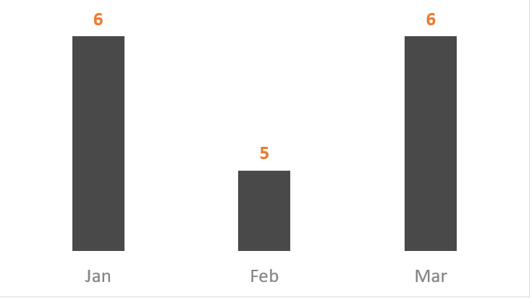
we can se from the previous slide that ekiti is responsible for almost zero sales and shoulde be closed down it also stopped selling from april

Slide 13
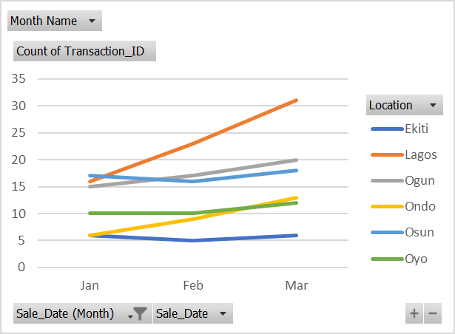
EKITI SALES WAS EXTREMELY LOW

Slide 14
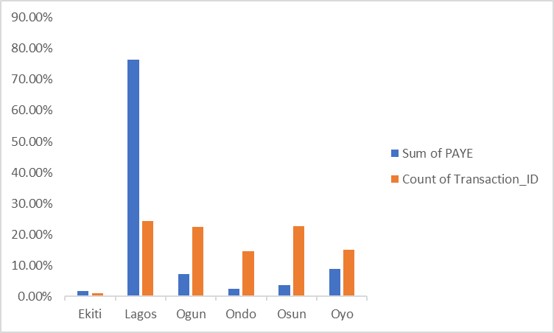
Body
Lagos has more income and population

Slide 15
90% of cars sold came from 5 brands
ROW LABELS | TOTAL QTY SOLD | %FILTERED BRAND
FORD | 368 | 24.7%
TOYOTA | 362 | 24.3%
HONDA | 203 | 13.6%
NISSAN | 201 | 13.5%
HYUNDAI | 198 | 13.3%
GRAND TOTAL | 1,332 | 89.3%

Slide 16
T0P 5 BRANDS
BOTTOM 4 BRANDS
FORD
CHEVROLET
TOYOTA
MERCEDES
HONDA
KIA
NISSAN
VOLKSWAGEN
HYUNDAI
3 M0DELS PER BRANCH
1 MODEL PER BRANCH

Slide 17
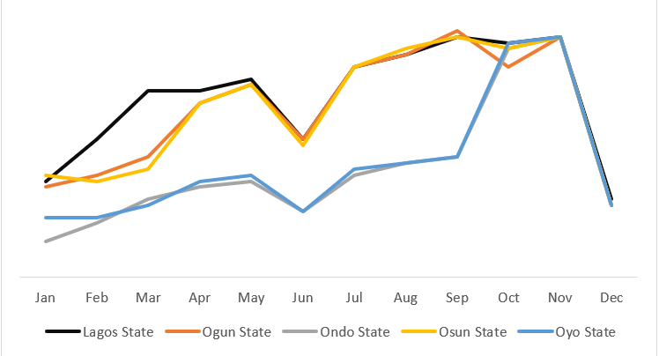
TOP BRANCHES HAD SIMILAR TRENDS IN JUNE,JULY AUGUST AND DECEMBER

Slide 18

SOLUTIONS AND RECOMMDATIONS
More branches should be open in lagos,ph or kano
Ekiti should be shut down
There should be atleast 3 brands and models in each branch
In as much as gender played no specific role the most act age range is 26-48 yrs

